Slide 1

WHO Performance Dashboard User Manual
Presented by George Ugochukwu

Slide 2
Outline
Introduction and Concept of Indicators
Male‑to‑Female Testing‑and‑Awareness Ratio (Age 15–49)
01
04
Top 10 & Bottom 10 States for Contraceptive Prevalence
States with Highest & Lowest Condom Usage
02
05
Dashboard Interpretation
Period of Noticeable Increase in HIV Prevalence
06
03

Slide 3
Introduction
Title
Purpose
WHO Performance Dashboard User Manual
Guide users through each charts, slicers, and the overall dashboard workflow.
Key Component → →
Indicator summary tiles, state-level map, disaggregation breakdowns trend analysis, gender ratio comparison.
Indicators Concept
When I built a monthly sales dashboard in Power BI, I added KPI cards and conditional formatting to create colored indicators that instantly showed me which product categories were underperforming—so I could spend my time addressing issues instead of digging through raw data.
An indicator is a simple visual, like a colored dot, arrow, gauge or KPI card, that shows at a glance whether a key metric is on track (e.g. “good,” “warning,” or “critical”).

Slide 4
Top 10 & Bottom 10 States for Contraceptive Prevalence
Slicer setup
Map
Bar Chart
Result
Indicators → select Contraceptive prevalence.
Data Source → choose MICS(and separately NDHS, NHMIS)
Period→ Pick 2016(then repeat for 2018 & 2019)
Hover over the largest bubbles → top ranked states.
Hover over the smallest bubbles → bottom-ranked states.
In the visual filters pane set a Top N filter: Top 10 by SumofValues, then remove it and set Bottom 10.
MICS 2016
Top 10 States: National, Enugu, Oyo, Adamawa, Niger, Kogi, Ekiti, North-West, South-South
Bottom 10 States: Bauchi, South-West, North-Central, Zamfara, Sokoto, Gombe, Bayelsa, Rivers, Akwa Ibom, Delta, Kaduna
(Note: No MICS data available for 2018 and 2019)

Slide 5
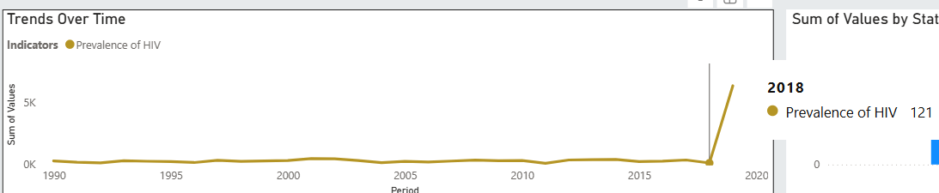
Period of Noticeable Increase in HIV Prevalence
04
Indicators → select HIV prevalence Look at the Trends Over Time line chart.
The steepest slope marks when prevalence surged.
For example, the steepest uptick occurs between 2018 and 2019.
For precision, hover on each year’s point to read the exact value.

Slide 6
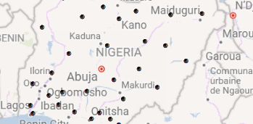
Male‑to‑Female Testing‑and‑Awareness Ratio (Age 15–49)
01
Indicators
Select HIV tested & aware (or however that indicator is named)
02
Age
Slicer → choose 15-49
03
Instructions
Look at the Disaggregation Pane:
The Pie chart by Gender shows the share of Male vs. Females.
The Bar chart by Age can also be toggled by gender.

Slide 7
States with Highest & Lowest Condom Usage
06
Indicators → select Condom usage (%)
Map or Bar chart
On the map, highest bubble = highest usage; smallest = lowest. Or re-use the “Top/Bottom 10” bar chart idea: set Visual filter → Top N = 1 and Bottom N = 1 to get the single highest/lowest state. Instructions
Select one or more indicators to focus the view.
Drag the scroll bar to zoom into a narrower period.

Slide 8
Dashboard Interpretation
Top 10 & Bottom 10 States for Contraceptive Prevalence
Period of Noticeable Increase in HIV Prevalence
Male‑to‑Female Testing‑and‑Awareness Ratio (Age 15–49)
States with Highest & Lowest Condom Usage
IHME 2016
Top State: National
Bottom State: National
(Note: No IHME data available for 2018 and 2019)
NHMIS 2018
Top 10 States: Plateau, Abia, Oyo, Katsina, Akwa Ibom, Kano, Imo, Kogi, Zamfara, Adamawa
Bottom 10 States: Kwara, Edo, Gombe, Delta, Cross River, Ekiti, Ogun, Osun, Bauchi, Bayelsa
The steepest increase in HIV prevalence occurred between 2018 and 2019, as seen in the Trends Over Time chart when filtered by the HIV prevalence indicator.
Among individuals aged 15–49:
480,000 males were tested for HIV and aware of their results.
560,000 females were tested and aware.
This gives a male-to-female ratio of approximately 0.86 : 1.
Highest Condom Usage: Edo State
Lowest Condom Usage: Jigawa State

